Slide 1
EDA of Anime Dataset
Prof. Manisha

Slide 2
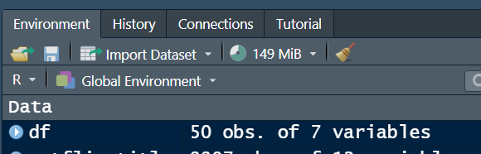
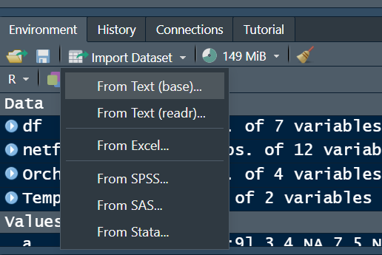
How to import Dataset?
Go to Environment and click on Import dataset and select From text(for CSV)

Slide 3
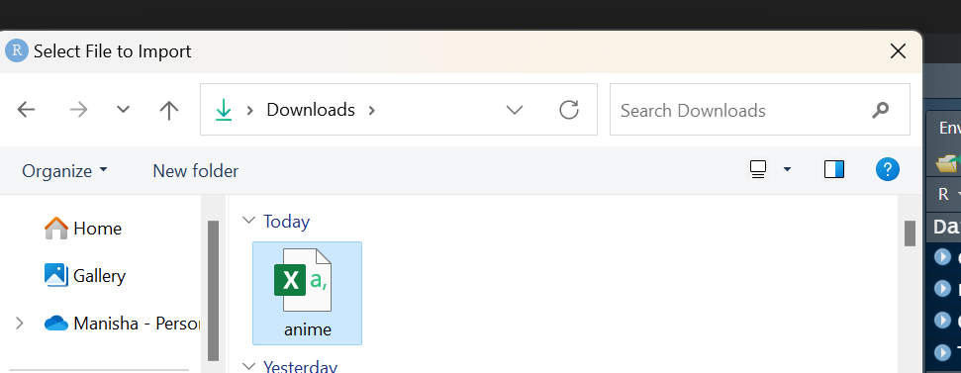
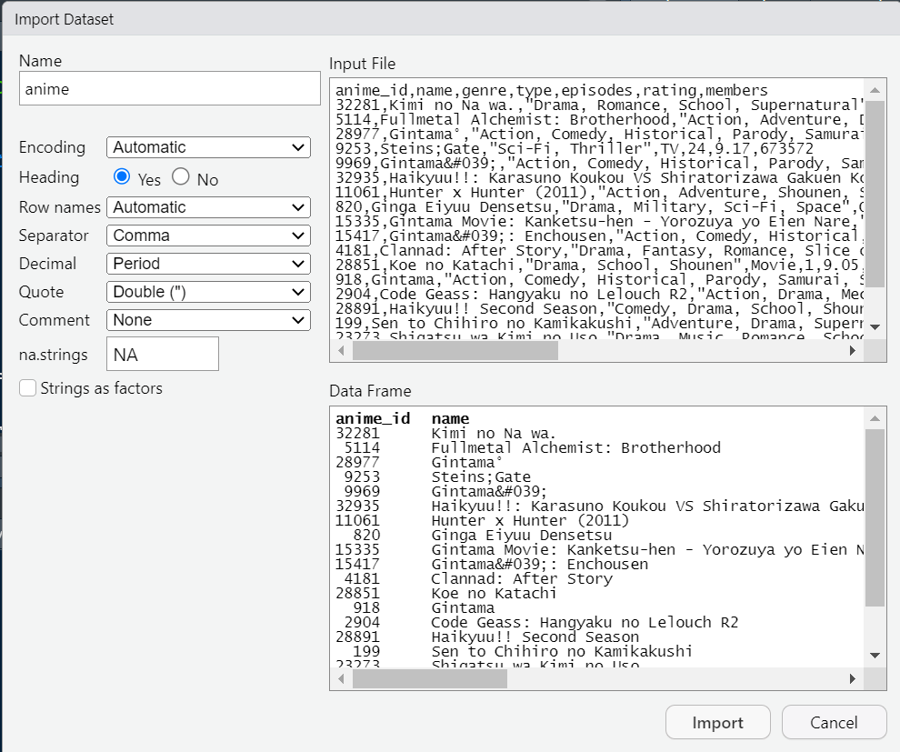
Select the Dataset and Check for all the options and click on Import.

Slide 4
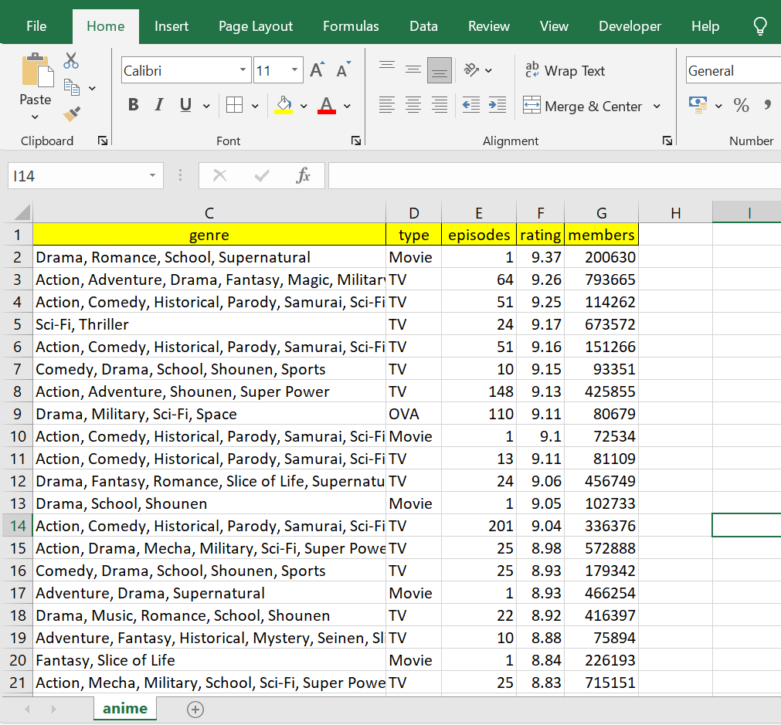

Slide 5
About DataSet
Data Source: https://www.kaggle.com/datasets/CooperUnion/anime-recommendations-database/data
Context
This data set contains information on user preference data from 73,516 users on 12,294 anime. Each user can add anime to their completed list and give it a rating and this data set is a compilation of those ratings.
Content
Anime.csv
anime_id - myanimelist.net's unique id identifying an anime.
name - full name of anime.
genre - comma separated list of genres for this anime.
type - movie, TV, OVA, etc.
episodes - how many episodes in this show? (1 if movie).
rating – an average rating out of 10 for this anime.
members - number of community members that are in this anime's "group".
Rating.csv
user_id – non-identifiable randomly generated user id.
anime_id - the anime that this user has rated.
rating - rating out of 10 this user has assigned (-1 if the user watched it but didn't assign a rating).comma-separated

Slide 6
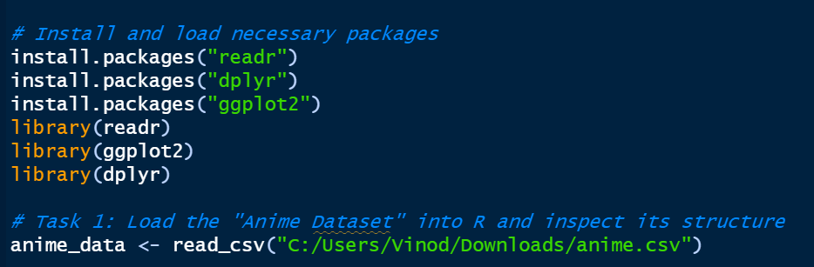
Import Library and Dataset
The code starts by installing three packages: readr, dplyr, and ggplot2. These are commonly used for data analysis in R.
readr is used for reading data from various formats, such as CSV and Excel files.
dplyr is used for data manipulation and wrangling.
ggplot2 is used for creating visualizations.

Slide 7

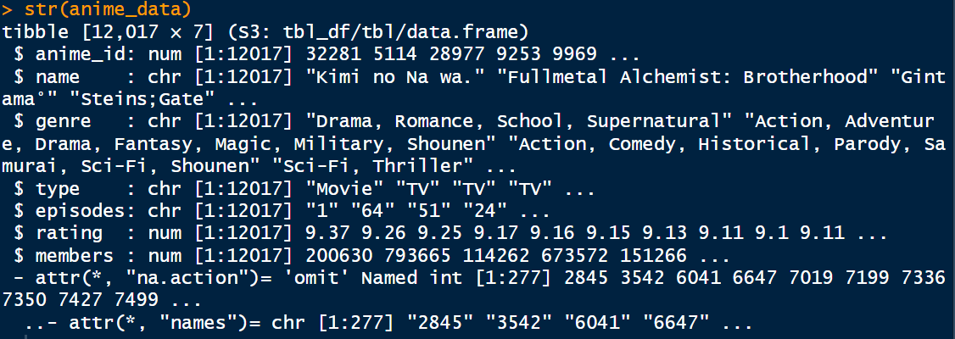
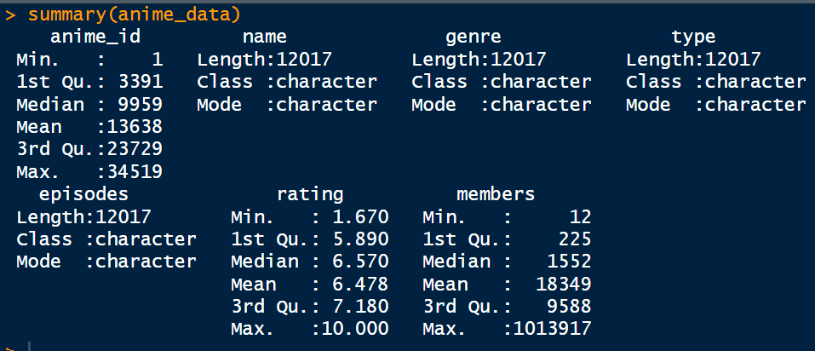
Structure of the Dataset

Slide 8
Structure of the Dataset
anime_id:
The dataset contains anime_id values ranging from 1 to 34519.
The median (9959) is the middle value, and the mean (13638) is the average.
The quartiles (3391, 9959, 23729) divide the data into four equal parts.
episodes:
There are 12,017 entries in the "episodes" column, represented as text (character data type).
rating:
Ratings range from 1.67 to 10, with a median of 6.57 and a mean of 6.478.
Quartiles provide insights into the spread of ratings.
members:
Viewership (members) ranges from 12 to 1,013,917.
The median viewership is 1552, and the mean is 18349.

Slide 9
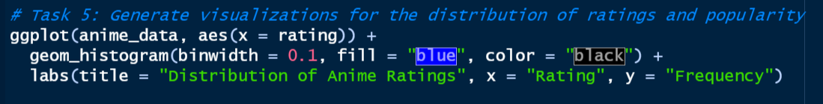
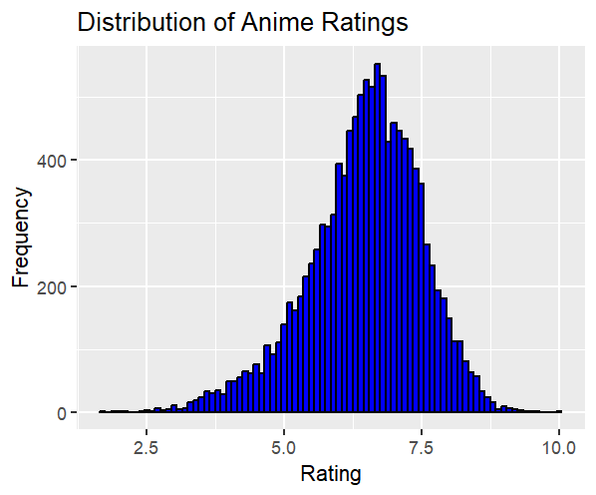
The graph shows that the distribution of anime ratings is right-skewed. This means that there are more anime with lower ratings than there are anime with higher ratings. The most common rating score is around 7.5, and there are very few anime rated below 5 or above 9.

Slide 10
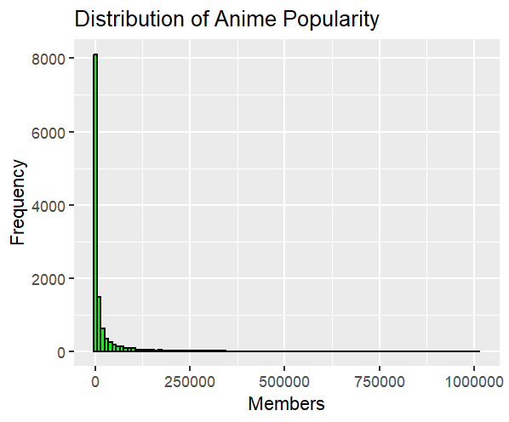
The graph shows that the distribution of anime popularity is left-skewed. This means that there are more anime with fewer members than there are anime with more members. The most common range of members is around 25,000 to 50,000, and there are very few anime with more than 750,000 members.

Slide 11
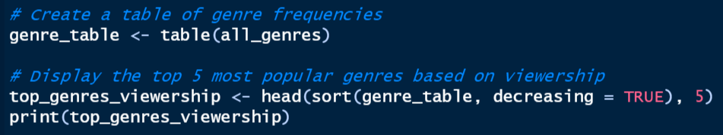
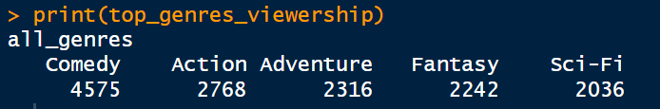
The table indicates that "Comedy" is the most frequently occurring genre, appearing 4575 times in the dataset.
Following "Comedy," the top 5 genres based on viewership frequencies are "Action," "Adventure," "Fantasy," and "Sci-Fi."

Slide 12
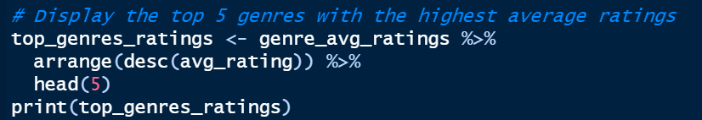
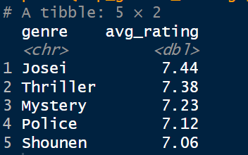
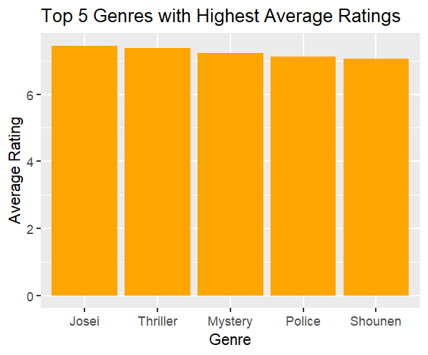
Interpretation:
The table shows the top 5 genres with the highest average ratings.
"Josei" has the highest average rating of 7.44, followed by "Thriller," "Mystery," "Police," and "Shounen."

Slide 13
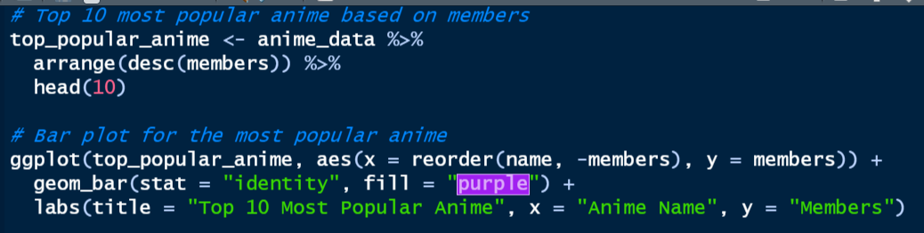
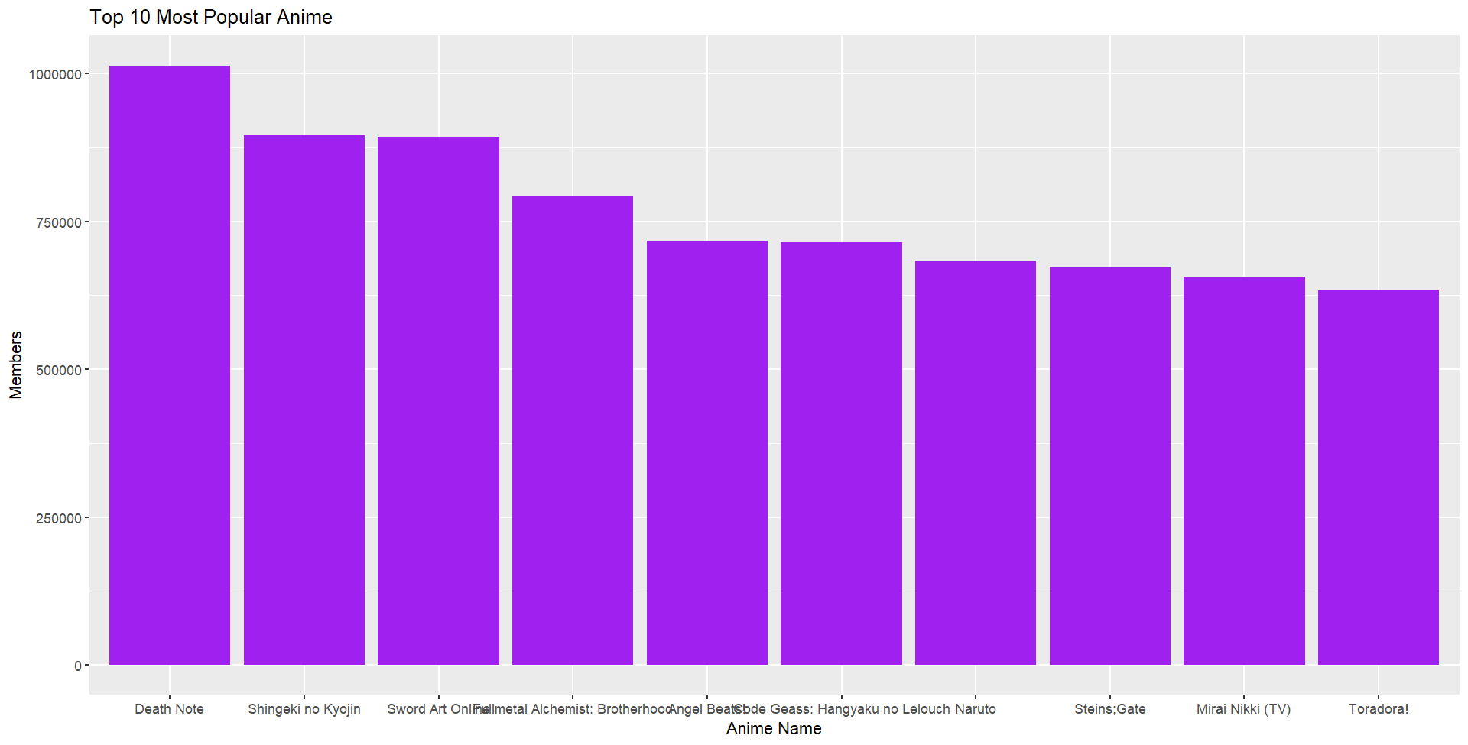
The distribution of ratings for both datasets appears to be right-skewed, meaning there are more anime with lower ratings than higher ratings.
The "Before COVID-19" data shows a slightly higher peak around the 7.5 rating score compared to the "After COVID-19" data. This suggests that there may have been a slight decrease in the proportion of highly-rated anime after the pandemic.
The "After COVID-19" data shows a slightly higher density around the 5.0 rating score compared to the "Before COVID-19" data. This suggests that there may have been a slight increase in the proportion of medium-rated anime after the pandemic.

Slide 14
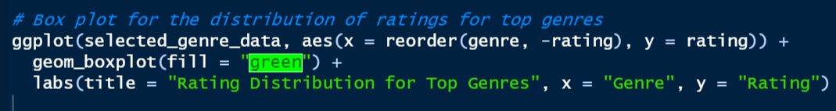
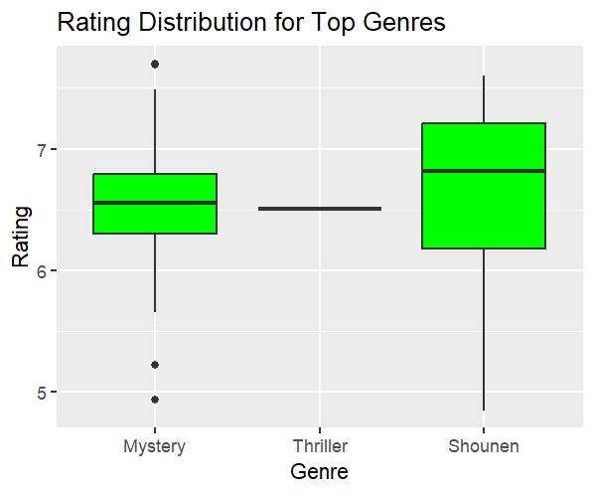
Interpretation:
The genres with the highest median ratings are Mystery and Thriller.
The genres with the lowest median ratings are Shounen and Sports.
The boxes for Mystery and Thriller are also relatively narrow, which means that there is less variation in ratings for these genres.
The boxes for Shounen and Sports are wider, which means that there is more variation in ratings for these genres.

Slide 15
Conclusion
Genre Average Ratings:
The code initially transforms the dataset by separating combined genres and calculating the average rating for each genre.
This process results in a tibble named genre_avg_ratings that contains genres and their corresponding average ratings.
Top 5 Genres with the Highest Average Ratings:
The code identifies and extracts the top 5 genres with the highest average ratings from the genre_avg_ratings tibble.
The resulting tibble, top_genres_ratings, contains information about these top-rated genres.
Output Interpretation:
The table displays the top 5 genres based on their average ratings.
"Josei" has the highest average rating (7.44), indicating that anime in this genre tends to receive favorable ratings.
Following "Josei," other top-rated genres include "Thriller" (7.38), "Mystery" (7.23), "Police" (7.12), and "Shounen" (7.06).
Implications:
The analysis provides valuable insights into genres that tend to receive higher ratings from viewers.
Creators and producers may find this information useful for understanding audience preferences and potentially shaping content strategies.
Viewers interested in genres with higher average ratings may explore anime within these top-rated categories.

